Slide 1
Waveguides

Slide 2
Types of waveguides
Parallel plate waveguides
Rectangular waveguides (applications in microwave engineering)
Circular waveguides (e.g. optical fiber)

Slide 3
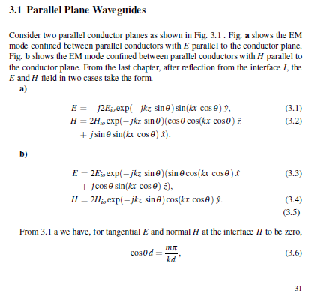

Slide 4
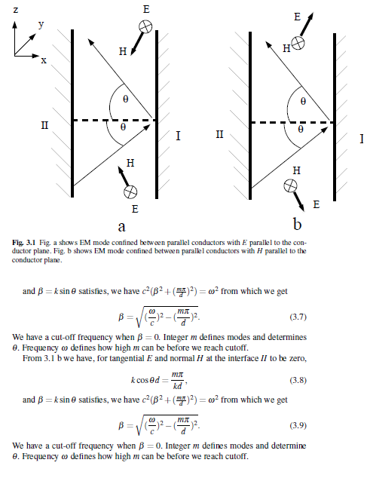

Slide 5
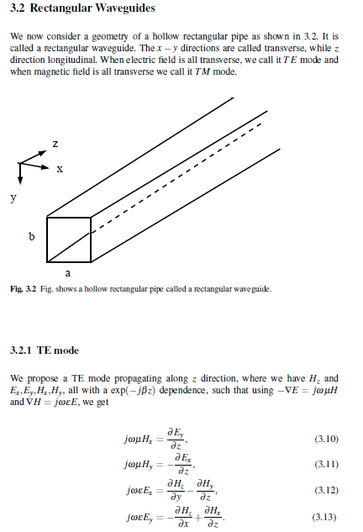

Slide 6
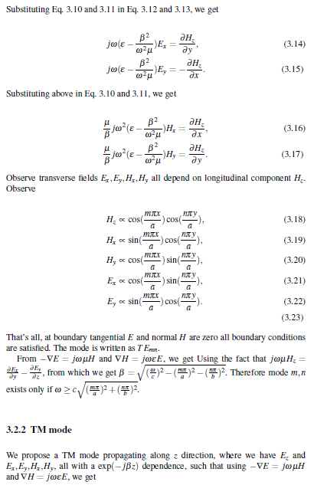

Slide 7
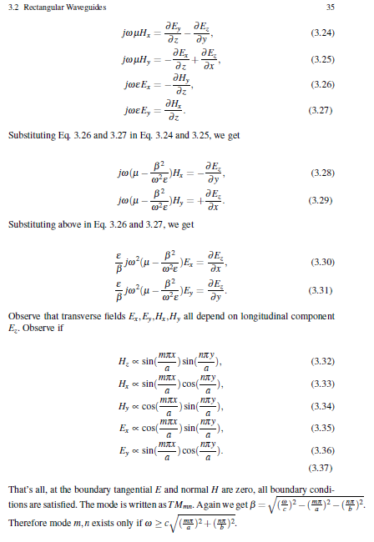

Slide 8
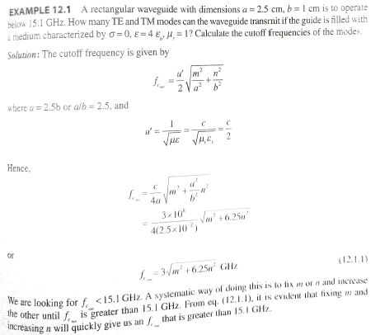

Slide 9
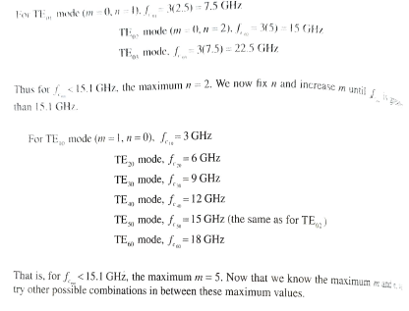

Slide 10
